Slide 1
Project Orion
A Wi-Fi OPTIMIZATION APP
Developed by Ahmet Nasuhcan ÜNLÜ | İlker MAVİLİ | Ozan İrfan BAYAR 171805062 | 181805084 | 171805041

Slide 2

Orion Constellation

Slide 3
What is Orion?
Orion is a Wi-Fi optimization app for Android.
The App aims at increasing Wi-Fi performance for users who have more than one wireless network in the same area.
These users want more efficient and more stable wireless network connections.
The application has the ability to switch to the Wi-Fi which has the strongest signal without needing manual intervention.
At the same time, the app tries to run with low battery consumption as much as possible.

Slide 4
Main Functional Requirements
• The device’s operating system must be Android.
• Permissions must be given as described below:
o File Read and Write Permission
o Wi-Fi Management Permission
• Android version must be at least 10 in order to use dark theme.

Slide 5
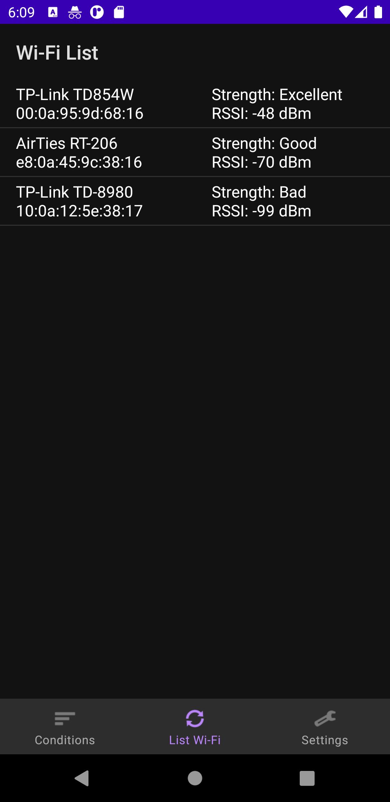
Main Functional Requirements
• User should be able to see signal strengths, SSIDs and BSSIDS from “Wi-Fi List” menu.

Slide 6
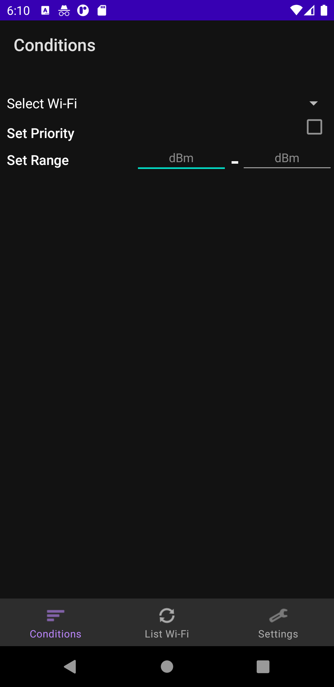
Main Functional Requirements
• User should be able to set priority of stations and set the range from the “List of Conditions” menu.

Slide 7
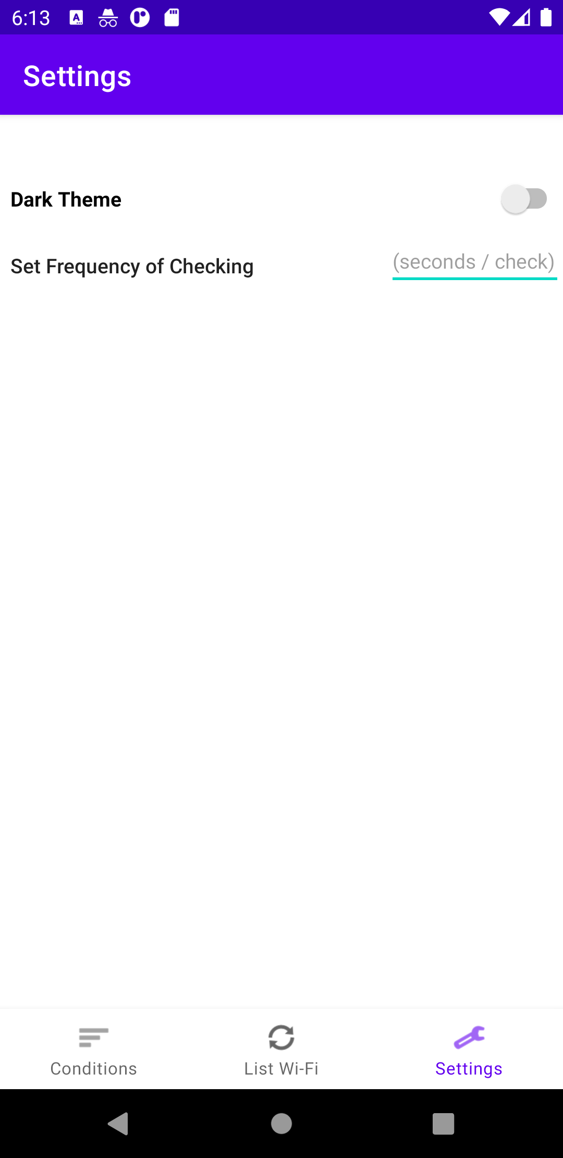
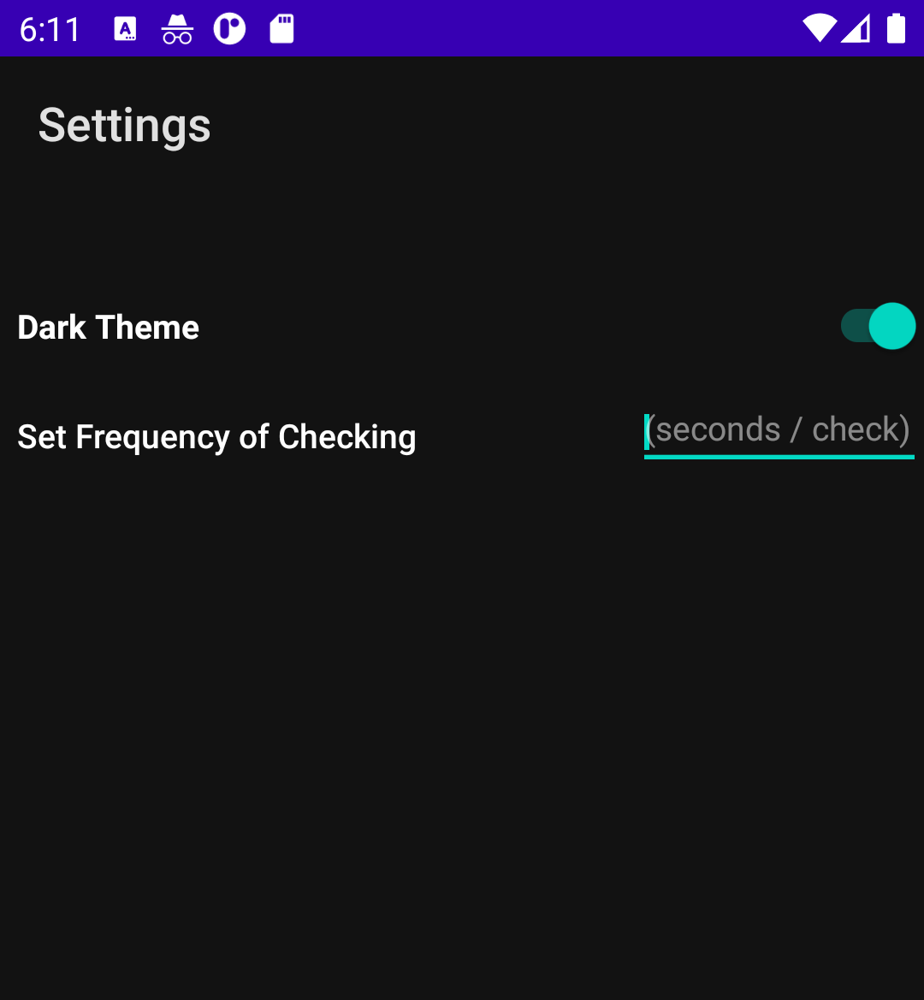
Main Functional Requirements
• User should be able to change the theme and set the checking rate from “Settings” menu.

Slide 8
Non-Functional Requirements
Security
Efficiency
• Privacy
• Compatibility
• Performance
• Manageability

Slide 9
Highlights of Product Backlog

Slide 10
Pre-Conditions | Post-Conditions
User must give permission to manage the Wi-Fi network control. | User can set the range according to dBm values on Wi-Fi list.
User must check the set priority box. | The application connects to the prioritized Wi-Fi’s first.
User must enter a value (sec/check). | Application will work periodically depending on the input value.
User must have at least Android 10 to use the dark theme. | The application runs with dark theme.

Slide 11
First Sprint Table
1st Sprint (Backlog) | 2nd Sprint (Developing and In-Process) | 3rd Sprint (Completed)
More Compatibility for Other Themes for Old Android Versions | User Manual for the First Time Users (Ahmet) | User Interface Design (İlker)
Range Recommendation System | Connectivity Area can be marked by user with Map (İlker) | Listing Wi-Fi Stations and Their Information (Ahmet)
 | Default ‘Frequency of Checking’ Value (Ozan) | Setting Range of the Signal Strength and Prioritizing Wi-Fi Stations (Ahmet)
 |  | Battery Usage Optimization (Ozan)

Slide 12
Inferences
We have improved our Collaboration Skills.
We have seen that the users have more specific demands about the application.
We realized how ruthless business life is.

Slide 13
Thanks for Watching and Listening Us
https://github.com/Anunlu/Project-Orion

